Slide 1

Dynamics of Order Execution Quality
An Analysis on net price improvement across market centers

Slide 2

Contents
Introduction
Background
Data Collection
Data Preprocessing
Research Design
Data Analysis
Results

Slide 3
Introduction
Objective: To evaluate the order execution quality of four major market centers using SEC Rule 605 filings.
Significance: Understanding how these centers perform in terms of net price improvement helps improve trading outcomes.

Slide 4
Background
SEC Rule 606: Discusses the transparency of order routing and execution practices.
SEC Rule 605: Focuses on public disclosure of execution quality by market centers.
Key Terms Defined: Net Price Improvement (NPI), Weighted-Mean and Weighted-Median of NPI.

Slide 5
Data Collection
The SEC Rule 605 filings for the market centers have been acquired by web scraping.
To obtain the requisite SEC Rule 605 filings for the designated market centers, the R code downloads the required files from the internet by scraping the market center websites.

Slide 6
Data Collection
The market centers considered for this project are - Citadel Securities LLC (TCDRG), Virtu Americas LLC(NITE, TVIRT, VIRT), Jane Street Capital (TJNST), and G1 Execution Services LLC (TETMM).
50 files (~4 years) for each market center is considered for this analysis.

Slide 7
Data Preprocessing
Combine 200 individual SEC 605 files into a single data frame.
1
Add ticker listing information.
2
Filter the data frame based on user input.
3
Convert order size and order type codes to understandable descriptions.
4
Add a calculated column for total executed shares.

Slide 8
Research Design
Calculate
Calculate Price Improvement and Deviation
Calculate
Calculate Net Value Improvement
Convert
Convert Net Value Improvement to cents
Calculate
Calculate Net Price Improvement by ticker
Calculate
Calculate Weighted Mean and Weighted Median of NPI

Slide 9
Data Analysis
Weighted Mean and Weighted Median of NPI have been calculated for all the market centers
By Ticker
By Order Type and Order Size
By S&P 500 Listing
By NYSE Listing
Time Series of W-Mean of NPI

Slide 10
By Ticker
Ticker | Highest W-Mean NPI | Highest W-Median NPI
AAPL | Citadel Securities LLC | G1 Execution Services LLC
AMZN | Citadel Securities LLC | G1 Execution Services LLC
GOOG | Citadel Securities LLC | Citadel Securities LLC

Slide 11
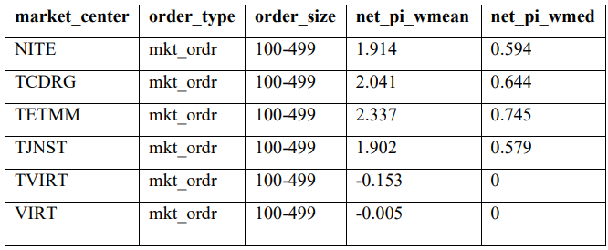
By Order Type and Order Size

Slide 12
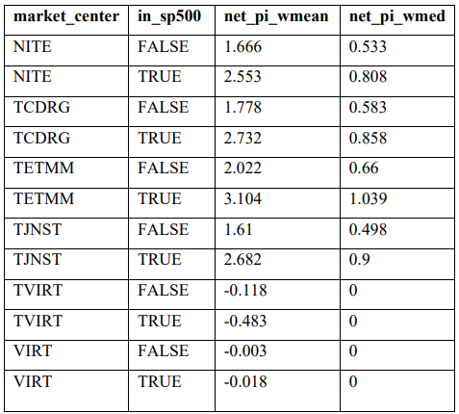
By S&P 500 Listing

Slide 13
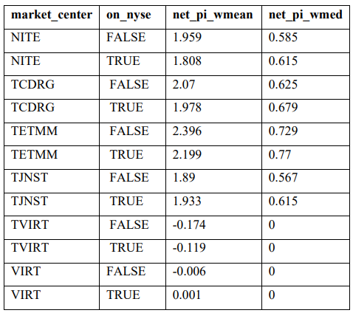
By NYSE Listing

Slide 14
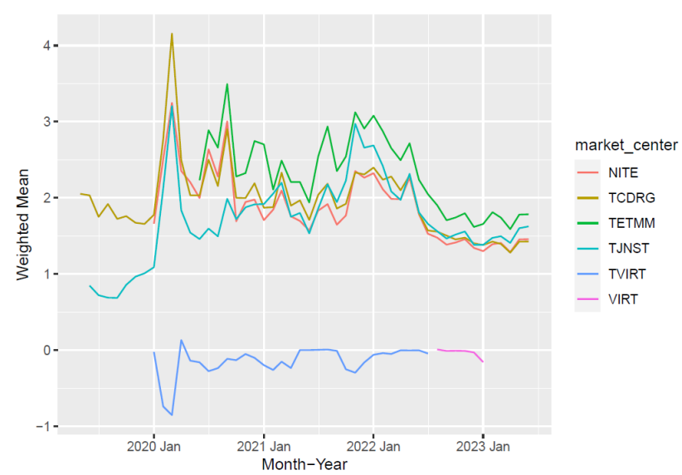
Time Series of W-Mean NPI

Slide 15
Results
By Ticker
Highest W-Mean NPI: TCDRG
By Order Type and Order Size
Highest W-Mean NPI: TETMM
Highest W-Median NPI: TETMM
Highest W-Median NPI: TETMM

Slide 16
Results
By S&P 500 Listing
Highest W-Mean NPI: TETMM
Highest W-Mean NPI: TETMM
By NYSE Listing
Highest W-Mean NPI: TETMM
Highest W-Mean NPI: TETMM

